Slide 1
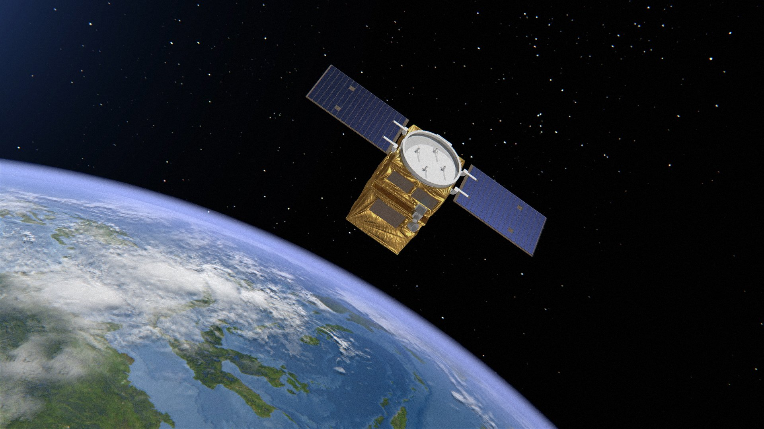
Safe Landings In Deep Space Using RL Techniques
RL 3547 – University Of Toronto – December 2019
Notes:
Image retrieved from: https://www.airbus.com/newsroom/press-releases/en/2018/06/Airbus-to-provide-an-end-to-end-Geo-Information-System-to-Thailand.html

Slide 2



THE TEAM
Adnan Lanewala
Naresh Patel
Nisarg Patel

Slide 3
AGENDA
Problem
Key Findings
Solution

Slide 4
Problem Statement
Satellite Cost
USD $10 – 400* million
*According to https://science.howstuffworks.com/satellite10.htm

Slide 5
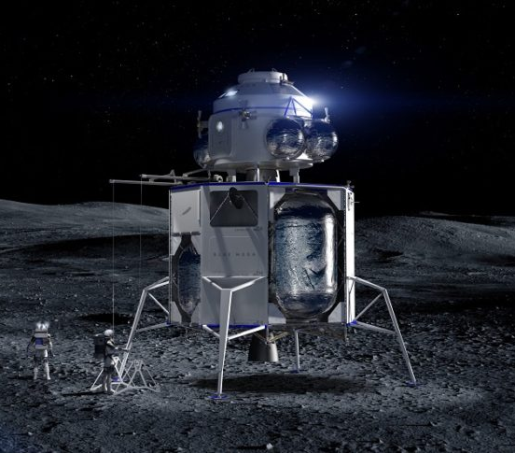

Problem Statement
Open AI Gym – Lunar Lander (v2) Environment

Slide 6
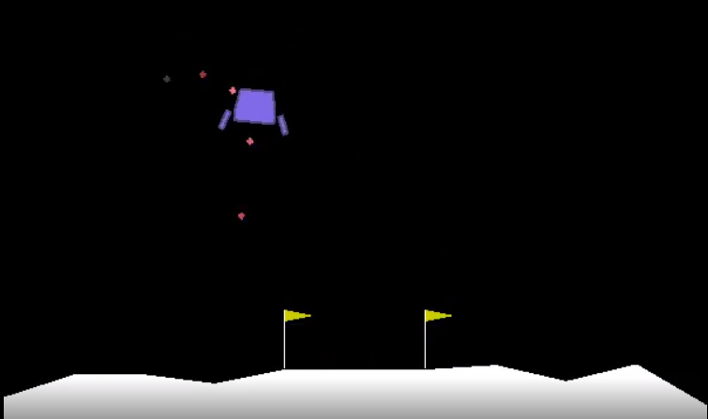
Action Space
4 Discrete Actions:
Fire Left Engine
Fire Right Engine
Fire Main Engine
Do Nothing
Left Engine
Right Engine
-0.03 points each frame
-0.03 points each frame
Main Engine
-0.3 points each frame
Landing Pad (0,0)

Slide 7
Reward
Crash | – 100 points
Come to Rest | + 100 points
Leg Contact | + 10 points
Zero Speed Touchdown | + (100 – 140) points
Solved | + 200 points
Firing Main Engine | – 0.3 points per frame
Firing Side Engine | – 0.03 points per frame
Fuel Supply | Unlimited

Slide 8
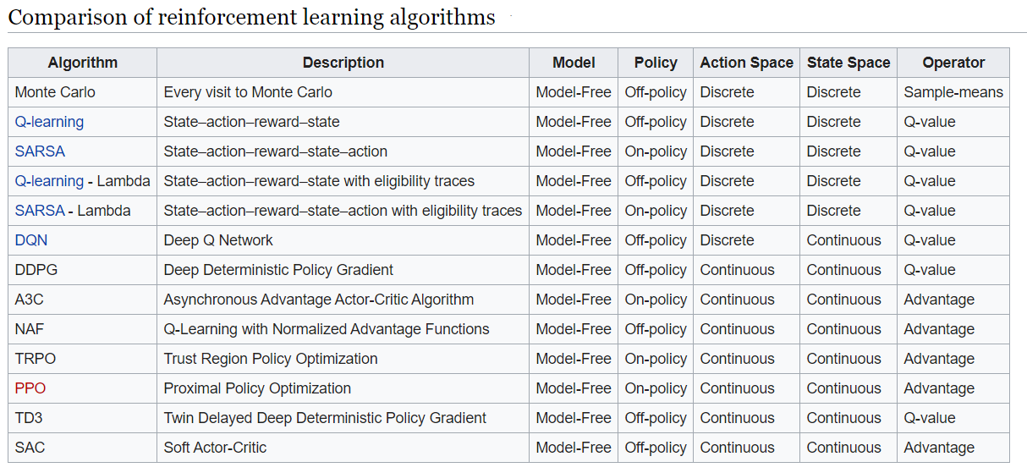
Solution – Algorithm
Information retrieved from https://en.wikipedia.org/wiki/Reinforcement_learning

Slide 9
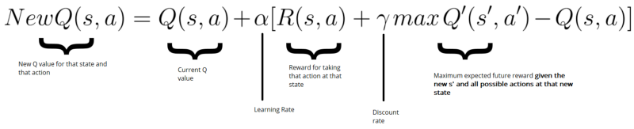

Solution – DQN
DQN
Q-Learning
Deep Neural Network
Notes:
Images retrieved from: https://en.wikipedia.org/wiki/Q-learning#Deep_Q-learning

Slide 10
Solution – Network
Hidden Dense Layer # 1
RELU
100 nodes
Hidden Dense Layer # 1
RELU
50 nodes
State Space (8 nodes)
(Input Layer)
Hidden Layers
Action Space (4 nodes)
(Output Layer)

Slide 11
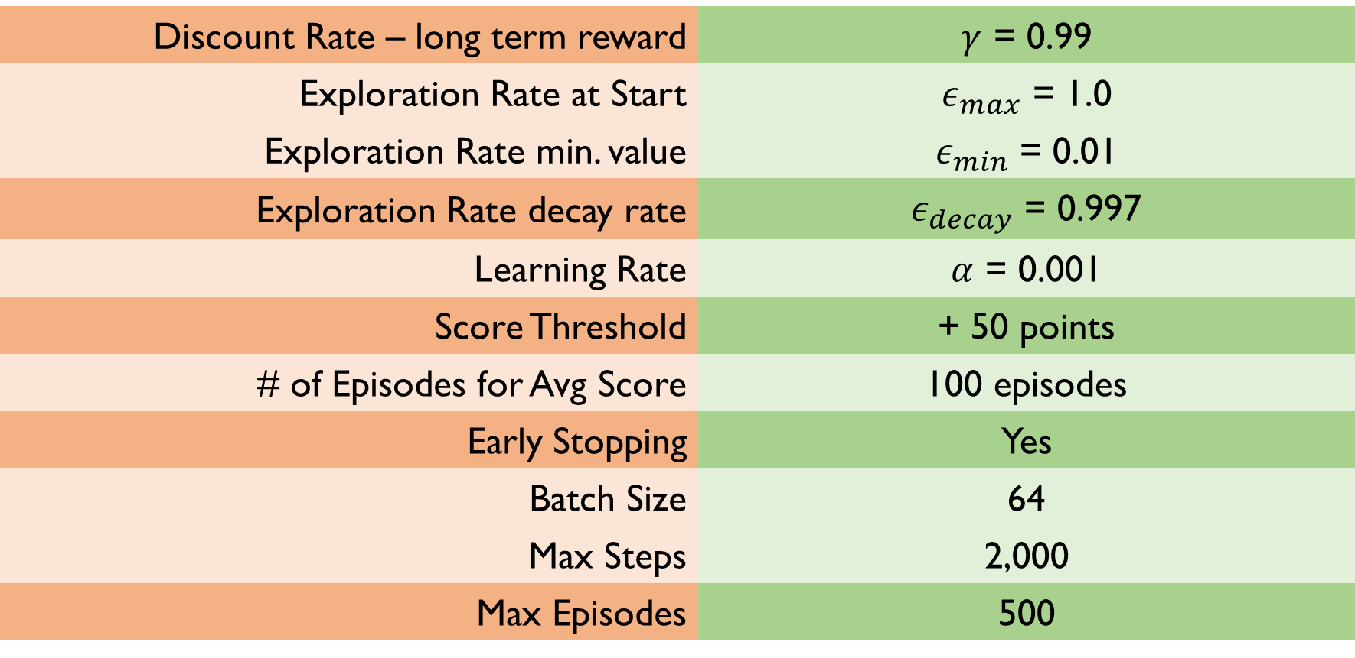
Solution – Parameters
Discount Rate – long term reward | $γ$ = 0.99
Exploration Rate at Start | $ε_{max}$ = 1.0
Exploration Rate min. value | $ε_{min}$ = 0.01
Exploration Rate decay rate | $ε_{decay}$ = 0.997
Learning Rate | $α$ = 0.001
Score Threshold | + 50 points
# of Episodes for Avg Score | 100 episodes
Early Stopping | Yes
Batch Size | 64
Max Steps | 2,000
Max Episodes | 500

Slide 12
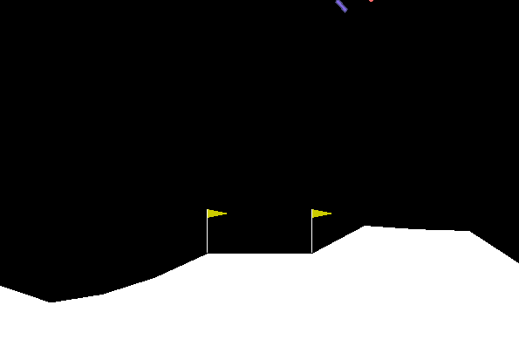
Solution – Training
Episode = 0

Slide 13
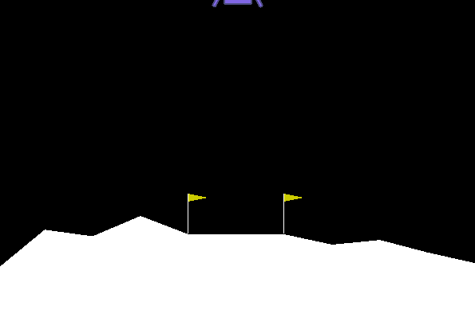
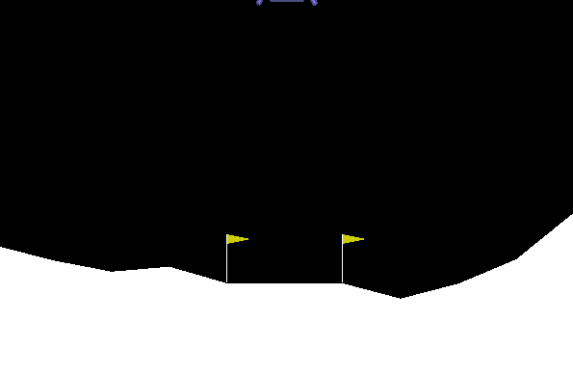
Solution – Training
Episode = 10
Episode = 50

Slide 14
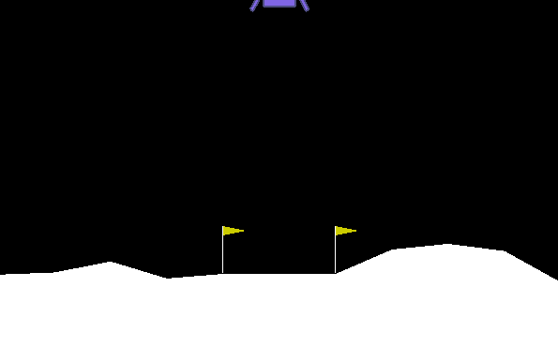
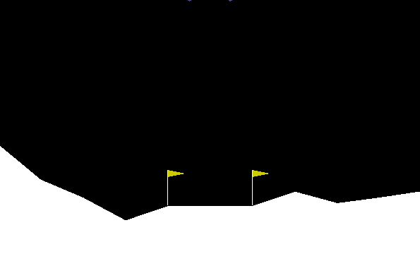
Solution – Training
Episode = 100
Episode = 150

Slide 15
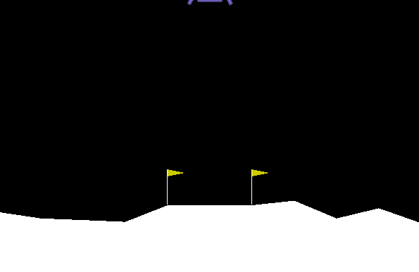
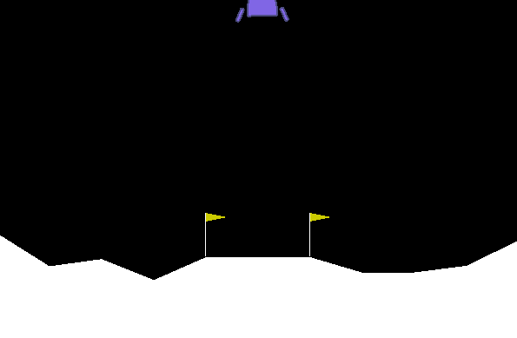
Solution – Training
Episode = 180
Episode = 198

Slide 16
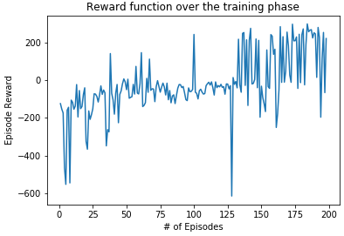
Solution – Outcome

Slide 17
Key Outcomes
Produced a generalized model that safely lands the satellite with good landing principles (approach)
+50 points
100 Episodes
Average Score
# of Episodes

Slide 18
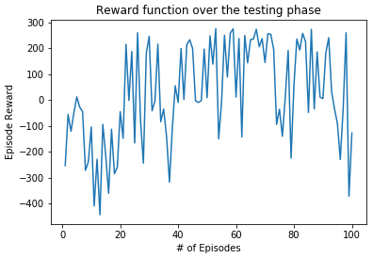
Test Results

Slide 19
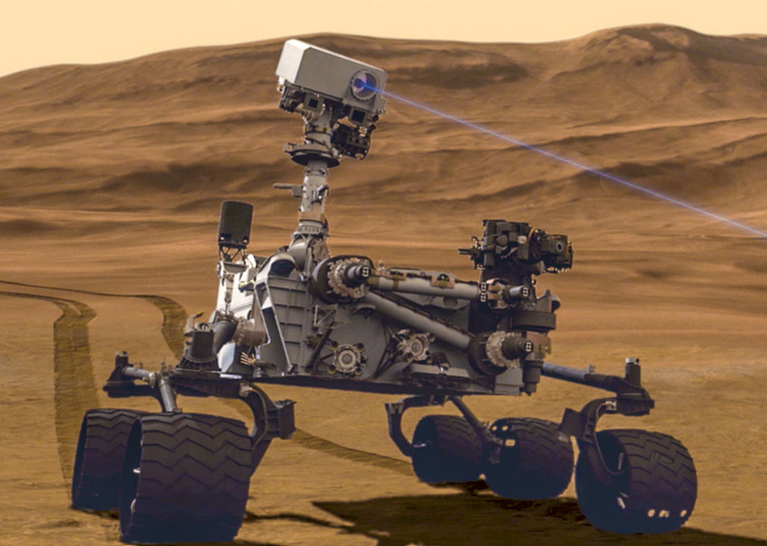

Thank You
https://github.com/nishp763/SCS-RL-3547-Final-Project
Notes:
Image retrieved from:

Slide 20
Appendix – Next Steps
Multi-agent & Collaboration
Different Algorithms (SARSA, Policy Iteration, RL techniques, Genetic mutations)
More Training with Higher Score threshold
Failure Simulation & Auto-correction (Engine Failure, Crosswind, Tumbling, Loss of Control)
Work with Limited Fuel Supply

Slide 21
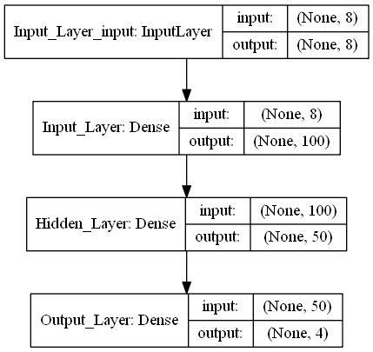
Appendix – Keras

Slide 22
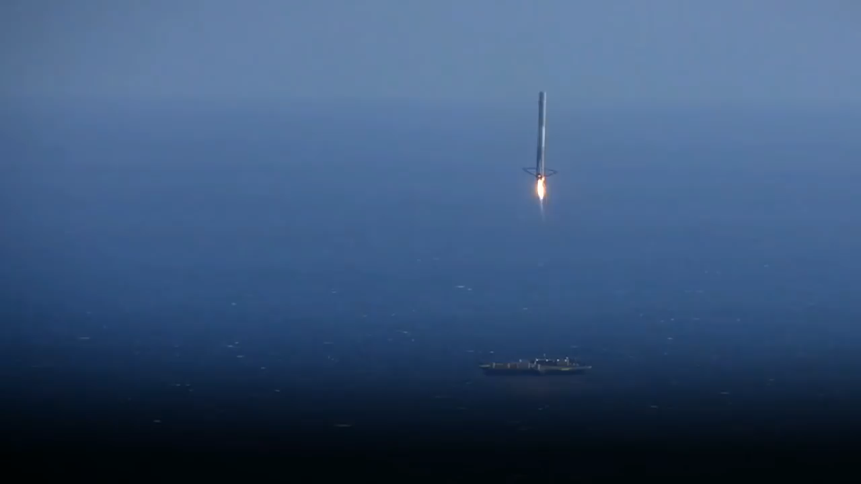
Notes:
Video retrieved from: https://www.youtube.com/watch?v=ambXDKFZhN8

